Slide 1

AMSTer : SAR & InSAR Automated Mass processing Software for Multidimensional Time series
Nicolas d’Oreye^{1,2}, Dominique Derauw^{3,4}, Sergey Samsonov⁵,
Delphine Smittarello¹, Maxime Jaspard¹, Gilles Celli¹
ndo@ecgs.lu
amster@ecgs.lu
1 European Centre for Geodynamics and Seismology (ECGS), 19 rue Josy Welter, L-7256 Walferdange, Luxembourg
2 National Museum of Natural History (NMNH), 19 rue Josy Welter, L-7256 Walferdange, Luxembourg
3 Centre Spatial de Liège (CSL), Avenue du Pré Aily, B-4031 Angleur, Belgium
4 SAREOS, 1 Rue des Violettes, 4557 Fraiture, Belgium
5 Canada Centre for Mapping and Earth Observation, Natural Resources Canada (NRCAN), 560 Rochester Street, Ottawa, ON K1A 0E4, Canada

Slide 2
Summer School in InSAR, time series processing and deformation modelling
Amplitude time series
Nicolas d’Oreye

Slide 3
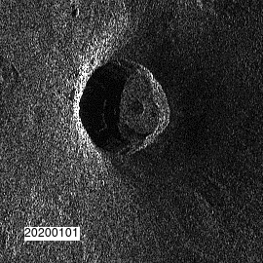

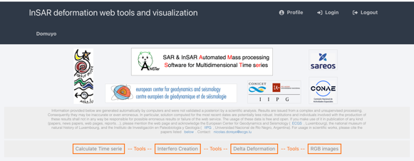
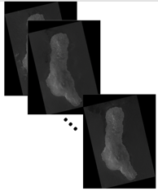
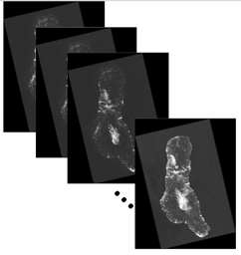
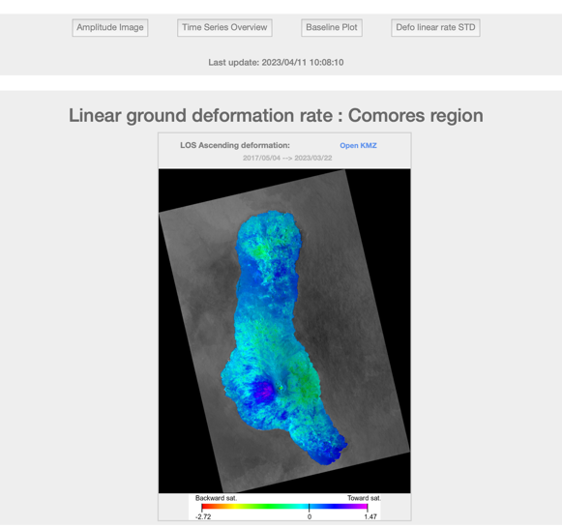
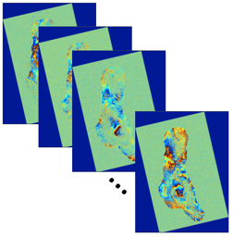
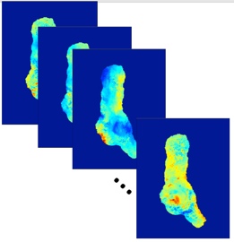
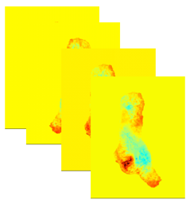
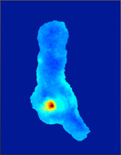
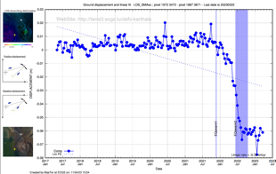
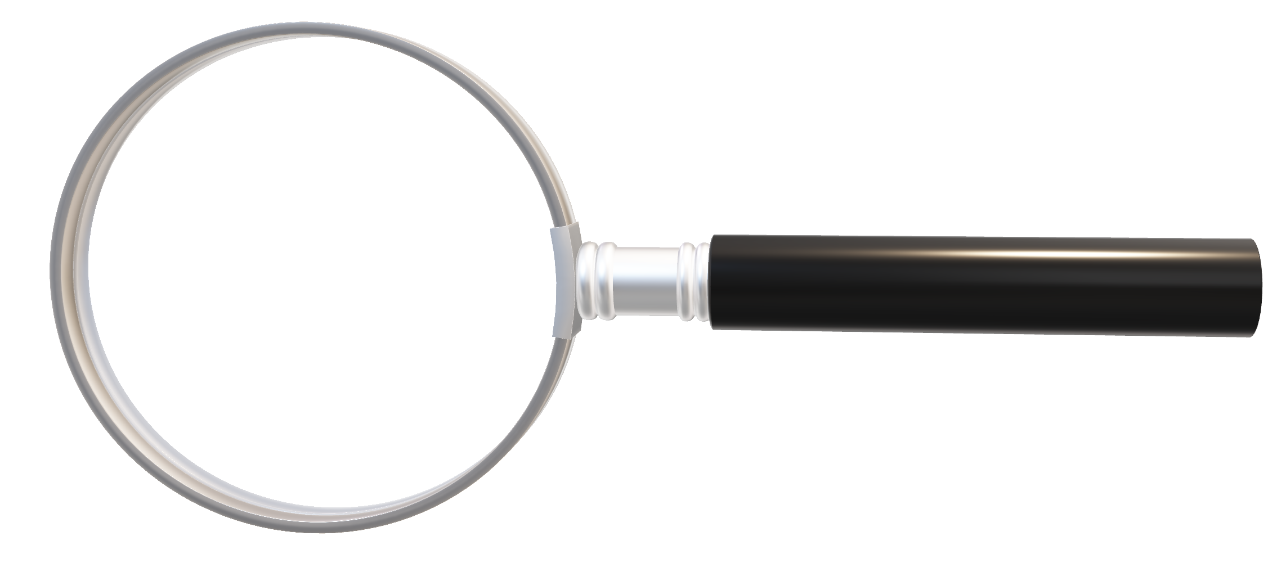
MasTer Toolbox
Sat. image
Download
Web Page(s)
Interferometric processing
(AMSTer Engine)
Ampli.
Coh.
Time Series processing
(MSBAS)
Ampli.
Defo.
Mean Veloc.
Interf.
Cumul. defo.
Defo.
ALL2GIF.sh
MultiLunch_Ampli_Coh.sh
Time series
G. Celli
D. Derauw
S. Samsonov
M. Jaspard
N. d’Oreye & D. Smittarello

Slide 4
Amplitude Time Series
Plan:
Why amplitude (coherence) time series ?
Only the amplitude in Slant Range + gif animation tagged with date :
ALL2GIF.sh
Corner offset
Pixel shape
Warning : hard coded lines
How geocode results
Amplitude and Coherence maps in slant range and geographical coord:
MultiLaunch_Ampli_Coh.sh
Other scripts:
For only one amplitude image: MakeAmpliPlotSingleImg.sh
For time series of other products: AllProd2GIF.sh
RGB composition:

Slide 5
Amplitude Time Series
Why amplitude (and/or coherence) time series ?
Geomorphological changes
Wild fires or inundations
Land cover changes
Height measurements from shadows
Pixel tracking

Slide 6
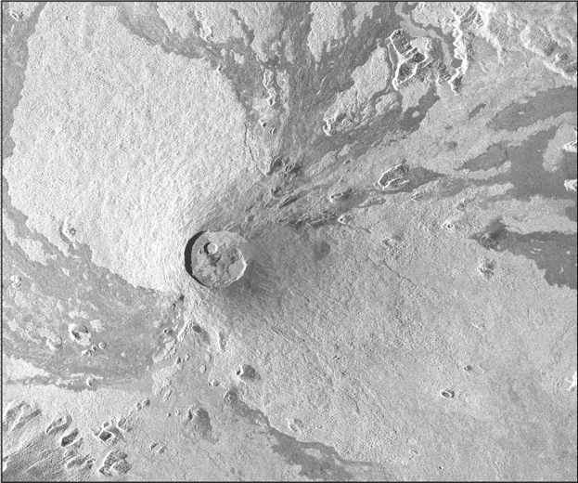
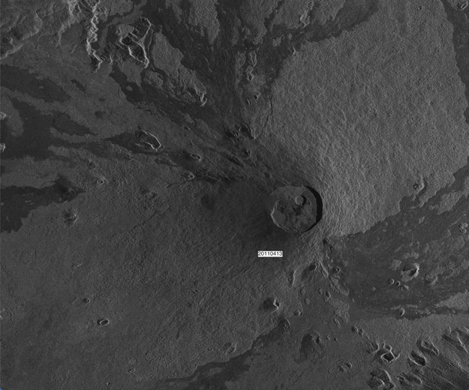
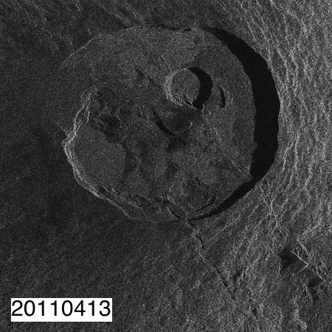
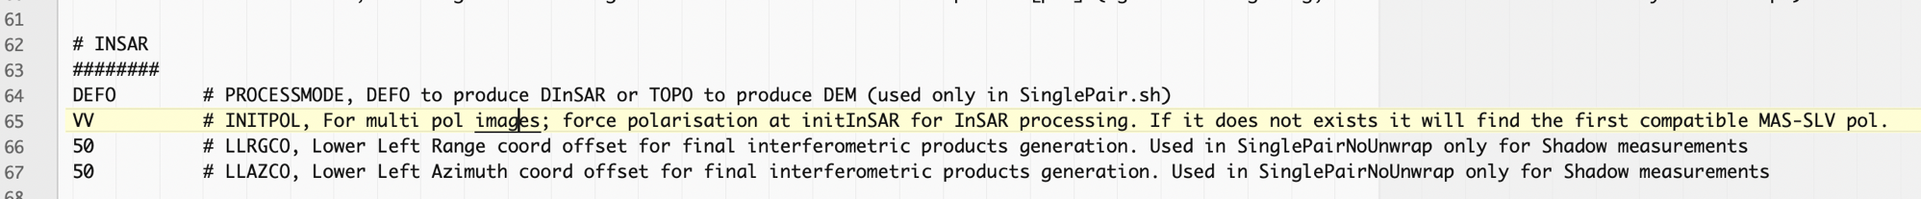
Amplitude Time Series
Why amplitude (coherence) time series ?
Only the amplitude in Slant Range + gif animation tagged with date:
ALL2GIF.sh
Corner offset
Why amplitude (coherence) time series ?
Only the amplitude in Slant Range + gif animation tagged with date:
ALL2GIF.sh
CSK descending,
Nyamulagira volcano.
The script will run a series of SinglePairNoUnwrap.sh (Combining the Global Primary (Super Master) & each image from the data base).
It will only focus on the amplitude images in slant range It will create
Amplitude images as Real32 binary matrix (+ ascii header) in radar geometry.
Amplitude images as Real32 binary matrix (+ ascii header) in radar geometry flipped or flopped to be as close as possible a natural orientation.
jpg files of these flipped/flopped images, with a date tag positionned wherever you need in the image
A gif animation with all the jpg images cropped to the size you need. Large crops were needed for coregistration.
Real32 binary matrix (+ ascii header) mimicks ENVI files, i.e. they can be open with QGIS, though without geographic reference, all aligned on the same grid. These are the products usually needed for analysis.
Note: S1 IW can be sigma nought calibrated
As usual, all scripts are incremental
Syntax: ALL2GIF.sh SMDATE LaunchMTparam.txt LabelX LabelY where SMDATE is the date of the Global Primary (Super Master), LabelX LabelY are the position of the date label in jpg image
If some images cause problem, check _List_Az_Rg_UpperLeft_coord.txt for pairs whose Upper right range and azimuth coordinate are not as expected (that is not the same as in _SizeOfCroppedAreaOfInterest.txt). Either discard these wrong images or try to adjust the parameters LLRGCO and LLAZCO in LaunchMTparam.txt (See manual § 3.2)

Slide 7
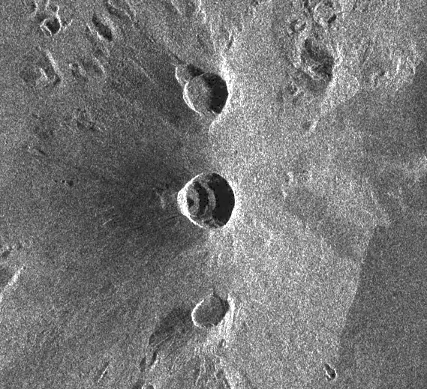
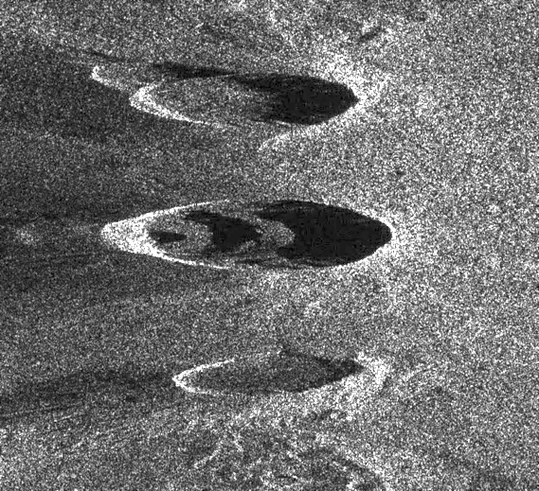
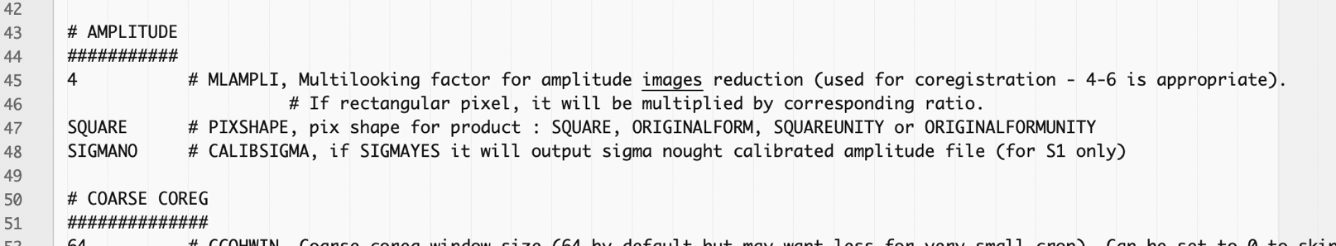
Amplitude Time Series
Why amplitude (coherence) time series ?
Only the amplitude in Slant Range + gif animation tagged with date:
ALL2GIF.sh
Corner offset
Pixel shape
S1 Desc 21 flopped image Nyiragongo crater
In LaunchMTparam.txt, the parameter PIXSHAPE let you decide if you want
to multilook your images in Range and Azimuth so that the final pixels look square, or
to compute your image while keeping the original form.
SQUARE is easier to visualise
ORIGINALFORM: pixel shape may allow to keep highest resolution e.g. for shadow length mesurements
SQUARED
ORIGINALFORM

Slide 8
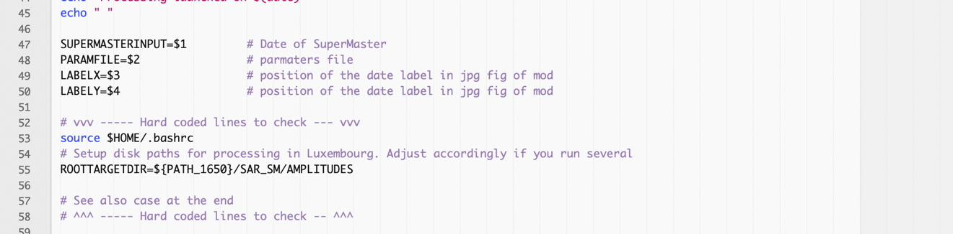
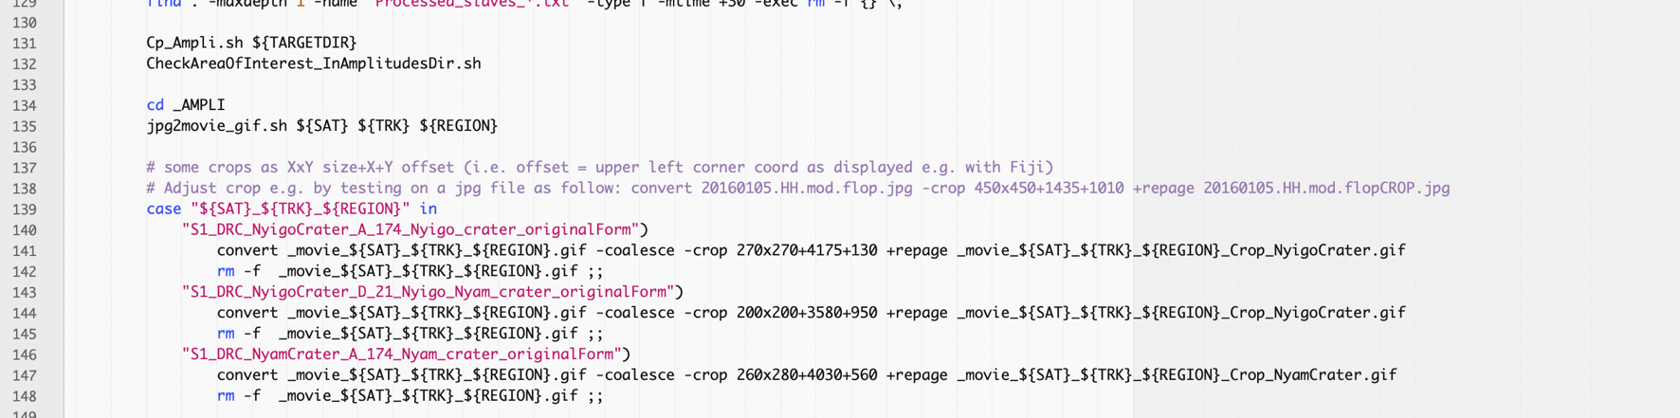
Amplitude Time Series
Why amplitude (coherence) time series ?
Only the amplitude in Slant Range + gif animation tagged with date:
ALL2GIF.sh
Corner offset
Pixel shape
Warning : hard coded lines
ALL2GIF.sh contains hardcoded lines:
The destination of computed amplitude images: ROOTTARGETDIR=${PATH_1650}/SAR_SM/AMPLITUDES
The size and position of the gif crop

Slide 9
Amplitude Time Series
Why amplitude (coherence) time series ?
Only the amplitude in Slant Range + gif animation tagged with date:
ALL2GIF.sh
Corner offset
Pixel shape
Warning : hard coded lines
How geocode results
If you need to geocode your results, this can be performed using the script Geocode_from_ALL2GIF.sh.
It must be launched in the …/SAR_SM/AMPLITUDES/SAT/TRK/REGION/ directory with a parameter file containing the desired details of the geocoding.
This parameter file has a structure slightly different from LaunchMTparam.txt files. See template in ___V20200812_LaunchParamReGeocAmpli.txt.
However, note that the script we will see next is doing it directly...

Slide 10
Amplitude Time Series
Why amplitude (coherence) time series ?
Only the amplitude in Slant Range + gif animation tagged with date
Amplitude and Coherence maps in slant range and geographical coord:
MultiLaunch_Ampli_Coh.sh
Unlike ALL2GIF.sh, which computes all the images with the Global Primary (Super Master), the script will run a series of SinglePair.sh using a list of pairs (several list formats are possible – see manual §3.5)
It will compute amplitude and (masked or unmasked) coherence images in slant range and in geographical coordinates It will create
Amplitude images as Real32 binary matrix (+ ascii header) in radar geometry, stored in _ALL_COH_SLANTRG _ALL_AMPLI_SLANTRG (and/or _ALL_AMPLI_SIGMA_SLANTRG for S1 IW)
Amplitude images as Real32 binary matrix (+ ascii header) in radar geometry , stored in _ALL_COH_GEOC
_ALL_AMPLI_GEOC (or _ALL_AMPLI_SIGMA_GEOC for S1 IW)
See manual §3.5 for syntax etc…

Slide 11
Amplitude Time Series
Why amplitude (coherence) time series ?
Only the amplitude in Slant Range + gif animation tagged with date
Amplitude and Coherence maps in slant range and geographical coord
Other scripts:
For only one amplitude image: MakeAmpliPlotSingleImg.sh
MakeAmpliPlotSingleImg.sh allows to create an amplitude images for only one image, e.g.
if only one image is available (no pair possible),
if no coregistration on a Global Primary (Super Master) is required, or
if speed is important, as it skips all processes other than what is needed to just compute the amplitude.
It requires a slightly different LaunchMTparameter.txt. See template in ___V20220719_LaunchParamAmpli.txt
See manual § 3.6 for more information

Slide 12


Amplitude Time Series
Why amplitude (coherence) time series ?
Only the amplitude in Slant Range + gif animation tagged with date
Amplitude and Coherence maps in slant range and geographical coord
Other scripts:
For only one amplitude image: MakeAmpliPlotSingleImg.sh
For time series of other products: AllProd2GIF.sh
AllProd2GIF.sh allows to create a gif animation with the geocoded product:
Coherence maps
Residual interferograms
Deformation maps
Amplitude
from all the pairs in the current directory.
See script for more information

Slide 13
Amplitude Time Series
Why amplitude (coherence) time series ?
Only the amplitude in Slant Range + gif animation tagged with date
Amplitude and Coherence maps in slant range and geographical coord
Other scripts:
For only one amplitude image: MakeAmpliPlotSingleImg.sh
For time series of other products: AllProd2GIF.sh
RGB composition:
AmpAmpAmp.sh allows to create a RGB composition by combining 2 amplitude maps (amp1 amp2 amp2) using Fiji. It requires amplitude images in ENVI format.
AmpAmpCoh.sh allows to create a RGB composition by combining 2 amplitude maps and a coherence image (amp1 amp2 coh) using Fiji. It requires amplitude images in ENVI format.
These are useful tools to track changes occuring between images such as flooding, lava flows emplacements etc...

Slide 14
Amplitude Time Series
Plan:
Why amplitude (coherence) time series ?
Only the amplitude in Slant Range + gif animation tagged with date :
ALL2GIF.sh
Corner offset
Pixel shape
Warning : hard coded lines
How geocode results
Amplitude and Coherence maps in slant range and geographical coord:
MultiLaunch_Ampli_Coh.sh
Other scripts:
For only one amplitude image: MakeAmpliPlotSingleImg.sh
For time series of other products: AllProd2GIF.sh
RGB composition:
- DONE ! -

